Slide 1
Question answering
Project presentation
Made by: Ashutosh Jadhav (2019bcs098)
Jayesh akot (2019bcs137)
suchit awate (2019bcs013)
Computer Science and Engineering Department
SHRI GURU GOBIND SINGHJI INSTITUTE OF ENGINEERING AND TECHNOLOGY, VISHNUPURI, NANDED.

Slide 2
contents
ABSTRACT
ACKNOWLEDGMENT
INTRODUCTION
SQuAD Dataset
BERT
PREPROCESSING
TOKENIZATION
FINE-TUNING
USE CASES
FUTURE SCOPE
CONCLUSION

Slide 3
ABSTRACT
Extractive Question Answering is a part of Natural Language Processing and Information Retrieval. A context is provided in Extractive Question Answering so that the model can refer to it and make predictions about where the answer is inside the passage. The SQuAD dataset, which is entirely task-based, is an example of a question-and-answer dataset. Data labeling for question-answering tasks (QA) is a costly procedure that requires oracles to read lengthy excerpts of texts and reason to extract an answer for a given question from within the text. QA is a task in natural language processing (NLP), where a majority of recent advancements have come from leveraging the vast corpora of unlabeled and unstructured text available online. This work aims to extend this trend in the efficient use of unlabeled text data to the problem of selecting which subset of samples to label in order to maximize performance. This practice of selective labeling is called active learning (AL).

Slide 4
acknowledgment
At the very beginning of preparing this report, I would like to convey my gratitude to my parents for their blessing in completing this report. I am obliged to all those people who helped me to organize this report and for their suggestions, instructions, and support with proper guidelines. Firstly, I would like to thank my honorable project supervisor and Project Coordinator U. V. Kulkarni, Professor, SGGSIE&T for their continuous guidance in completing this report. His valuable advice has helped me a lot in preparing this report properly. I am really thankful to him for the support that he has provided.

Slide 5
introduction
Question Answering models can retrieve the answer to a question from a given text, which is useful for searching for an answer in a document.
This task comes in many flavors, but the one we’ll focus on is called extractive question answering. This involves posing questions about a document and identifying the answers as spans of text in the document itself.
We will fine-tune a BERT model on the SQuAD dataset, which consists of questions posed by crowdworkers on a set of Wikipedia articles. This will give us a model able to compute predictions like this one:

Slide 6
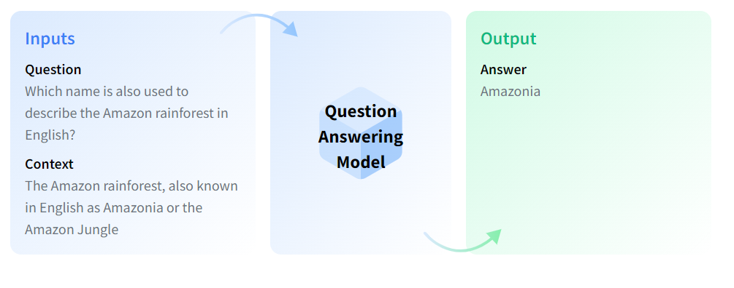

Slide 7
SQuAD Dataset
The dataset that is used the most as an academic benchmark for extractive question answering is SQuAD, so that’s the one we’ll use here.
Stanford Question Answering Dataset (SQuAD) is a reading comprehension dataset, consisting of questions posed by crowd workers on a set of Wikipedia articles, where the answer to every question is a segment of text, or span, from the corresponding reading passage
The dataset comes fully labelled and presplit into training, validation and test sets, the distribution of which is as follows:
• Train: 87,599
• Dev: 10,570
• Test: 9,533

Slide 8
Example –
Context: Architecturally, the school has a Catholic character. Atop the Main Building's gold dome is a golden statue of the Virgin Mary. Immediately in front of the Main Building and facing it, is a copper statue of Christ with arms upraised with the legend "Venite Ad Me Omnes". Next to the Main Building is the Basilica of the Sacred Heart. Immediately behind the basilica is the Grotto, a Marian place of prayer and reflection. It is a replica of the grotto at Lourdes, France where the Virgin Mary reputedly appeared to Saint Bernadette Soubirous in 1858. At the end of the main drive (and in a direct line that connects through 3 statues and the Gold Dome), is a simple, modern stone statue of Mary.
Question: To whom did the Virgin Mary allegedly appear in 1858 in Lourdes France?
Answer: {'text': ['Saint Bernadette Soubirous'], 'answer_start': [515]}

Slide 9
BERT
BERT is an open-source machine learning framework for natural language processing (NLP). BERT is designed to help computers understand the meaning of ambiguous language in a text by using surrounding text to establish context. The BERT framework was pre-trained using text from Wikipedia. The BERT model was pretrained on BookCorpus, a dataset consisting of 11,038 unpublished books and English Wikipedia (excluding lists, tables and headers)and can be fine-tuned with question-and-answer datasets
BERT, which stands for Bidirectional Encoder Representations from Transformers, is based on Transformers, a deep learning model in which every output element is connected to every input element, and the weightings between them are dynamically calculated based upon their connection. (In NLP, this process is called attention.)
BERT is different because it is designed to read in both directions at once.

Slide 10
The goal of any given NLP technique is to understand human language as it is spoken naturally. In BERT's case, this typically means predicting a word in a blank. To do this, models typically need to train using a large repository of specialized, labeled training data. This necessitates laborious manual data labeling by teams of linguists.
BERT, however, was pre-trained using only an unlabeled, plain text corpus (namely the entirety of the English Wikipedia, and the Brown Corpus). It continues to learn unsupervised from the unlabeled text and improve even as its being used in practical applications (i.e Google search). Its pre-training serves as a base layer of "knowledge" to build from. From there, BERT can adapt to the ever-growing body of searchable content and queries and be fine-tuned to a user's specifications. This process is known as transfer learning.

Slide 11
BERT is a transformers model pretrained on a large corpus of English data in a self-supervised fashion. This means it was pretrained on the raw texts only, with no humans labelling them in any way (which is why it can use lots of publicly available data) with an automatic process to generate inputs and labels from those texts. More precisely, it was pretrained with two objectives: 1. Masked language modeling (MLM): taking a sentence, the model randomly masks 15% of the words in the input then run the entire masked sentence through the model and has to predict the masked words. This is different from traditional recurrent neural networks (RNNs) that usually see the words one after the other, or from autoregressive models like GPT which internally mask the future tokens. It allows the model to learn a bidirectional representation of the sentence. 2. Next sentence prediction (NSP): the models concatenates two masked sentences as inputs during pretraining. Sometimes they correspond to sentences that were next to each other in the original text, sometimes not. The model then has to predict if the two sentences were following each other or not. This way, the model learns an inner representation of the English language that can then be used to extract features useful for downstream tasks: if you have a dataset of labeled sentences for instance, you can train a standard classifier using the features produced by the BERT model as inputs.

Slide 12
Processing the training data
The processing of training data in an extractive question answering (QA) model involves certain steps

Slide 13
Preprocessing:
The training data, which typically consists of question-answer pairs, undergoes preprocessing to clean and normalize the text. This may involve removing unnecessary characters, punctuation, or special symbols, and converting the text to lowercase. Additionally, any noise or irrelevant information may be filtered out to improve the quality of the training data

Slide 14
TOKENIZATION
Tokenization in question answering models refers to the process of breaking down a piece of text, such as a sentence or a paragraph, into smaller units called tokens. Tokens are typically individual words, but they can also be subwords or characters, depending on the tokenization strategy used.
In question answering models, tokenization is an essential step because it allows the model to understand and process the input text effectively. By tokenizing the text, the model can analyze each token separately and capture the relationships between them.
Tokenization involves several tasks, including separating words, removing punctuation, handling contractions, and converting text to lowercase. It also handles more complex cases, such as splitting words into subwords to handle out-of-vocabulary words or rare terms.
Once the text is tokenized, each token is usually assigned a unique identifier or index, which enables the model to represent the text as a sequence of numbers. These tokenized sequences are then fed into the question answering model for further processing

Slide 15
[CLS] question [SEP] context [SEP] EXAMPLE '[CLS] To whom did the Virgin Mary allegedly appear in 1858 in Lourdes France? [SEP] Architecturally, ''the school has a Catholic character. Atop the Main Building's gold dome is a golden statue of the Virgin ''Mary. Immediately in front of the Main Building and facing it, is a copper statue of Christ with arms ''upraised with the legend " Venite Ad Me Omnes ". Next to the Main Building is the Basilica of the Sacred ''Heart. Immediately behind the basilica is the Grotto, a Marian place of prayer and reflection. It is a ''replica of the grotto at Lourdes, France where the Virgin Mary reputedly appeared to Saint Bernadette ''Soubirous in 1858. At the end of the main drive ( and in a direct line that connects through 3 statues ''and the Gold Dome ), is a simple, modern stone statue of Mary. [SEP]'

Slide 16
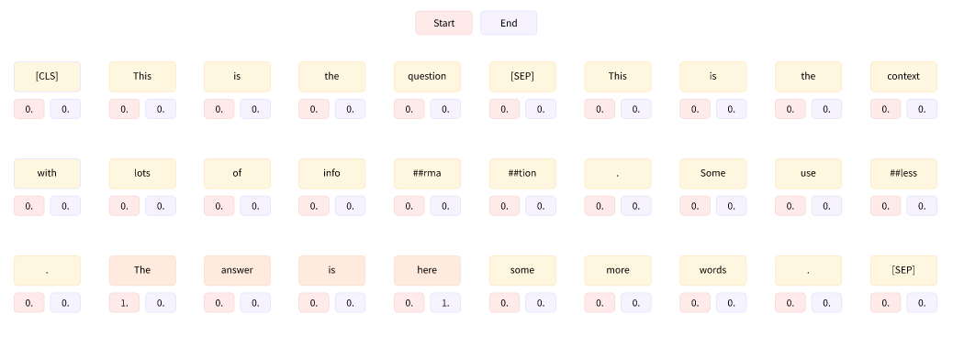
Generate labels for the question’s answer, which will be the start and end positions of the tokens corresponding to the answer inside the context.
The labels will then be the index of the tokens starting and ending the answer, and the model will be tasked to predicted one start and end logit per token in the input, with the theoretical labels being as follow:

Slide 17
'[CLS] To whom did the Virgin Mary allegedly appear in 1858 in Lourdes France? [SEP] Architecturally, the school has a Catholic character. Atop the Main Building\'s gold dome is a golden statue of the Virgin Mary. Immediately in front of the Main Building and facing it, is a copper statue of Christ with arms upraised with the legend " Venite Ad Me Omnes ". Next to the Main Building is the Basilica of the Sacred Heart. Immediately behind the basi [SEP]'
'[CLS] To whom did the Virgin Mary allegedly appear in 1858 in Lourdes France? [SEP] the Main Building and facing it, is a copper statue of Christ with arms upraised with the legend " Venite Ad Me Omnes ". Next to the Main Building is the Basilica of the Sacred Heart. Immediately behind the basilica is the Grotto, a Marian place of prayer and reflection. It is a replica of the grotto at Lourdes, France where the Virgin [SEP]'
'[CLS] To whom did the Virgin Mary allegedly appear in 1858 in Lourdes France? [SEP] Next to the Main Building is the Basilica of the Sacred Heart. Immediately behind the basilica is the Grotto, a Marian place of prayer and reflection. It is a replica of the grotto at Lourdes, France where the Virgin Mary reputedly appeared to Saint Bernadette Soubirous in 1858. At the end of the main drive ( and in a direct line that connects through 3 [SEP]'
'[CLS] To whom did the Virgin Mary allegedly appear in 1858 in Lourdes France? [SEP]. It is a replica of the grotto at Lourdes, France where the Virgin Mary reputedly appeared to Saint Bernadette Soubirous in 1858. At the end of the main drive ( and in a direct line that connects through 3 statues and the Gold Dome ), is a simple, modern stone statue of Mary. [SEP]'

Slide 18
Our example has been split into four inputs, each of them containing the question and some part of the context.
The answer to the question (“Bernadette Soubirous”) only appears in the third and last inputs, so by dealing with long contexts in this way we will create some training examples where the answer is not included in the context.
For those examples, the label will be start_position = end_position = 0
We will also set those labels in the unfortunate case where the answer has been truncated so that we only have the start (or end) of it. For the examples where the answer is fully in the context, the labels will be the index of the token where the answer starts and the index of the token where the answer ends.

Slide 19
Processing the validation data
The validation data refers to a subset of the available labeled data that is used to evaluate the performance of a trained model. It is distinct from the training data and is employed to assess how well the model generalizes to unseen examples.
In extractive question answering (QA) models, the validation data is used to evaluate the performance of the model during the training process. Once the validation data is preprocessed and encoded, it is used to evaluate the model's performance. The model takes the encoded input, such as tokenized questions, and generates predictions for the answer spans in the text. These predicted answer spans are compared against the ground truth answer spans in the validation data. Evaluation metrics such as Exact match or F1 score are then calculated to assess how well the model performs on the validation data.

Slide 20
Fine-tuning The Model
-The model has been trained to predict the index of the token starting the answer and the index of the token where the answer ends This model return two tensors of logits: one for the logits corresponding to the start token of the answer, and one for the logits corresponding to the end token of the answer.
-We mask the indices that are not part of the context. Our input is [CLS] question [SEP] context [SEP] , so we need to mask the tokens of the question as well as the [SEP] token.
-We will compute the probabilities of each possible start_index and end_index where start_index <= end_index, then take the tuple (start_index, end_index)
with the highest probability.
-To go faster, we also won’t score all the possible (start_token, end_token) pairs, but only the ones corresponding to the highest n_best logits (n_best = 20).

Slide 21
We will use AdamW as an optimizer, which is like Adam, but with a fix in the way weight decay is applied.
Training Loop, which is the classic iteration over the train_dataloader, forward pass through the model, then backward pass and optimizer step.
The evaluation, in which we gather all the values for start_logits and end_logits before converting them to NumPy arrays. Once the evaluation loop is finished, we concatenate all the results.
Accuracy :- 88.67%

Slide 22
USE CASES
• Information Retrieval: Extractive QA models can be used to retrieve specific information from large collections of documents or knowledge bases. Users can ask questions, and the model can provide precise answers by extracting relevant information from the available sources.
• Customer Support and FAQs: Companies often employ extractive QA models to automate customer support and frequently asked questions (FAQs) systems. Users can ask questions about products, services, or common issues, and the model can provide instant and accurate responses by extracting answers from the company's knowledge base or documentation.
• News and Article Summarization: Extractive QA models can summarize news articles or lengthy documents by extracting the most relevant information and answering questions about the key points. This allows users to quickly grasp the main ideas without reading the entire text.
• Educational Assistance: Extractive QA models can assist in education by answering questions from students or providing explanations for specific concepts. Students can ask questions related to their coursework, and the model can extract relevant information from textbooks, lecture notes, or educational resources to provide answers and explanations.

Slide 23
• Legal and Compliance: Extractive QA models can be used in the legal domain to assist with legal research, contract analysis, or compliance-related tasks. Lawyers, legal professionals, or compliance officers can ask questions about specific legal documents, regulations, or case law, and the model can extract relevant information to support their work.
• Healthcare: Extractive QA models have applications in healthcare for tasks such as medical question answering, patient education, and clinical decision support. Users, including patients or healthcare professionals, can ask questions about symptoms, diseases, treatment options, or drug interactions, and the model can provide answers by extracting information from medical literature or trusted sources.
• Virtual Assistants and Chatbots: Virtual assistants and chatbot applications can leverage extractive QA models to provide human-like interactions and answer user queries. Users can ask general knowledge questions, get recommendations, or seek assistance with various tasks, and the model can extract relevant answers from the available knowledge sources.
• Technical Support: Extractive QA models can be employed in technical support scenarios, such as IT help desks or troubleshooting systems. Users can ask questions about technical issues or error messages, and the model can extract relevant answers or solutions from technical documentation or knowledge bases to assist with problem resolution.

Slide 24
• Interviewing and Recruitment: Extractive QA models can be utilized in the interviewing and recruitment process. Interviewers can ask questions to assess a candidate's knowledge, skills, or problem-solving abilities, and the model can extract answers from the candidate's resume or relevant documents for evaluation.
• Language Learning: Extractive QA models can aid language learning by providing answers and 22 explanations to language-related questions. Users can ask questions about grammar rules, vocabulary, idioms, or language usage, and the model can extract information from language resources to provide accurate responses.
These are just a few examples of the use cases where extractive QA models can be applied. The versatility and accuracy of these models make them valuable in a wide range of industries and applications, facilitating quick access to relevant information and improving user experiences.

Slide 25
FUTURE SCOPE
• Model Performance: Enhancing the performance of extractive QA models is an ongoing focus. Future research can explore novel architectures, model ensembles, and techniques to further improve accuracy, especially in handling complex questions and challenging passages. Continued advances in pre-training techniques, such as self-supervised learning, can also contribute to better model performance.
• Multi-Lingual QA: Expanding extractive QA models to support multiple languages is an important future direction. Currently, most models are trained and evaluated on English-language datasets like SQuAD. Extending QA models to other languages would enable wider accessibility and applicability in diverse linguistic contexts.
• Cross-Domain Generalization: Extractive QA models often struggle to generalize well across different domains. Future research can focus on techniques that enable models to adapt and perform well in various domains, even with limited or no domain-specific training data. This would enhance the versatility and practicality of extractive QA models.
• Multi-Hop Reasoning: Extractive QA models primarily focus on answering questions that require information from a single passage or document. Enabling models to perform multi-hop reasoning, where answers may require information aggregation or inference from multiple sources, is an important future research direction. This would allow QA models to handle more complex queries that involve deeper understanding and reasoning.

Slide 26
• Contextual Understanding: Extractive QA models primarily rely on the local context within the passage to identify the answer span. Future work can explore techniques to incorporate a broader context, such as a collection of related documents or a knowledge graph, to improve the model's understanding and ability to answer questions that require global context.
• Beyond Extractive Answers: While extractive QA models focus on extracting the answer span from the passage, future research can explore methods to generate more abstractive answers. This would involve generating answers in a more natural language form, summarizing relevant information from the passage, or providing additional context to enhance the answer's quality and readability.
• Adversarial Evaluation: Developing robust evaluation methodologies for extractive QA models is an ongoing challenge. Future work can explore adversarial evaluation techniques to identify and address model weaknesses, such as sensitivity to paraphrases, adversarial examples, or subtle linguistic variations. This would help ensure the reliability and generalizability of extractive QA models.
• Real-Time QA: Enabling extractive QA models to operate in real-time scenarios with low latency requirements is an important future scope. Efficient model architectures, optimization techniques, and hardware acceleration can contribute to real-time question answering, enabling applications in chatbots, virtual assistants, and other interactive systems.

Slide 27
• Domain-Specific QA: Extractive QA models can be further specialized for specific domains, such as healthcare, legal, or technical domains. Customized training on domain-specific datasets and incorporating domain-specific knowledge sources can improve the model's performance in specialized domains.
• Explainability and Trust: Addressing the black-box nature of extractive QA models is crucial for building trust and understanding their decision-making. Future research can focus on developing techniques to provide explanations for model predictions, highlighting the relevant evidence used to generate the answer, and enabling users to understand and verify the model's reasoning process.
These future scopes hold immense potential for advancing extractive QA models, making them more accurate, versatile, and applicable across various domains and languages. Continued research and innovation in these areas will contribute to the development of more advanced and capable extractive QA systems.

Slide 28
Conclusion
In this work, we propose a novel method for Supervised span selection. We showed that by finetuning a pretrained model, one can get considerable gains in terms of time, money and power. You can use Question Answering (QA) models to automate the response to frequently asked questions by using a knowledge base (documents) as context. Answers to customer questions can be drawn from those documents. This project focused on training an extractive question answering (QA) model by fine-tuning the BERT (Bidirectional Encoder Representations from Transformers) model on the SQuAD (Stanford Question Answering Dataset) dataset. The objective was to enable the model to accurately predict answer spans given a passage and a corresponding question. Through the project, we followed a comprehensive methodology, including preprocessing the training data, processing the validation data, and postprocessing the model predictions. We finetuned the BERT model by updating its parameters using backpropagation and optimizing it with a suitable loss function.

Slide 29
The results of the fine-tuning process were evaluated on the validation set using metrics such as the F1 score and exact match (EM) score to measure the model's performance. Hyperparameter tuning was performed to optimize the model's configuration. By fine-tuning BERT on the SQuAD dataset, we successfully adapted the powerful language model for the extractive QA task. The model demonstrated the ability to accurately extract answer spans from the given passages, showing promising performance in providing precise answers to user questions. However, there are still opportunities for further improvement and exploration. Future research could focus on enhancing the model's performance by investigating novel architectures, incorporating multi-hop reasoning, enabling better cross-domain generalization, and exploring abstractive answer generation. Overall, this project highlights the effectiveness of fine-tuning BERT on the SQuAD dataset for training an extractive QA model. The learned model can be leveraged in various applications, such as information retrieval, customer support, education, and more, where accurate and efficient question answering is required.

Slide 30
THANK YOU

